Slide 1


Analysis
SPOTIFY DANCE MUSIC
LEON BITTIS
SERGEJ KURTASCH

Slide 2





Project Overview
Dataset and Its Origin
6 tables from kaggle.com , 3 Gb
5.7 million electronic music tracks + artists names.
10 characteristics of tracks, such as loudness, duration, mood, danceability, popularity, etc.
Business Problem
identify correlation between characteristics and popularity
formulate recommendations for successfully promoting new releases

Slide 3

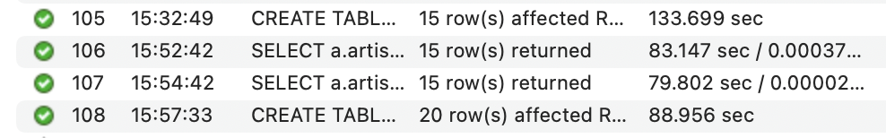
Challenges
1. High execution time for each operation with the database.
2. Data cleaning and unification of data types.
3. Organizational solutions for linking tables via foreign keys.

Slide 4


DATABASE DESIGN
Database Design

Slide 5
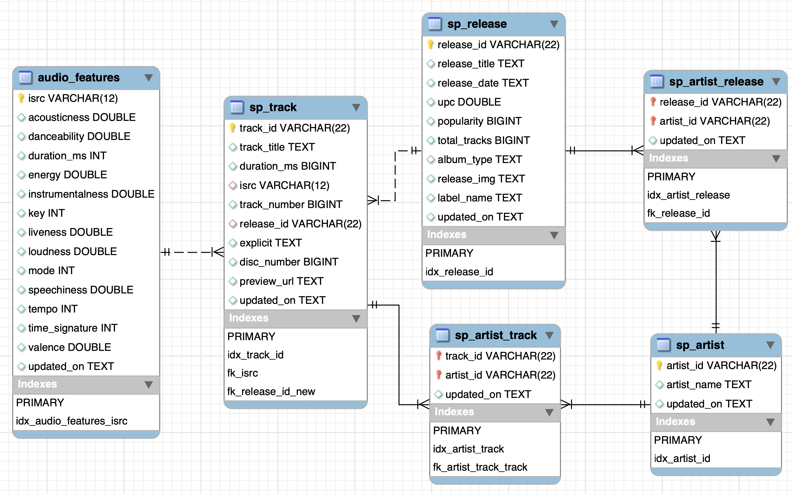
Database Design

Slide 6

DATA ANALYSIS

Slide 7
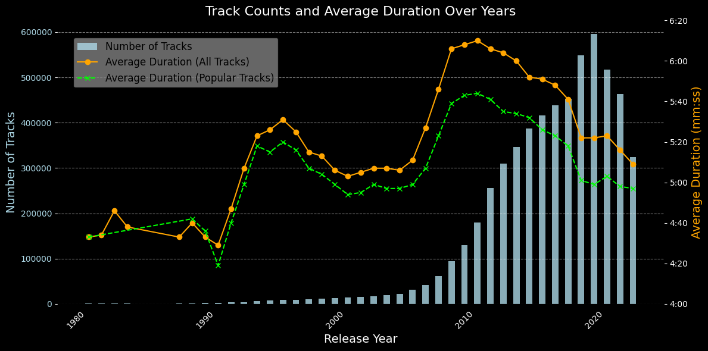
Average Duration Over Years
OF THE MONTH

Slide 8
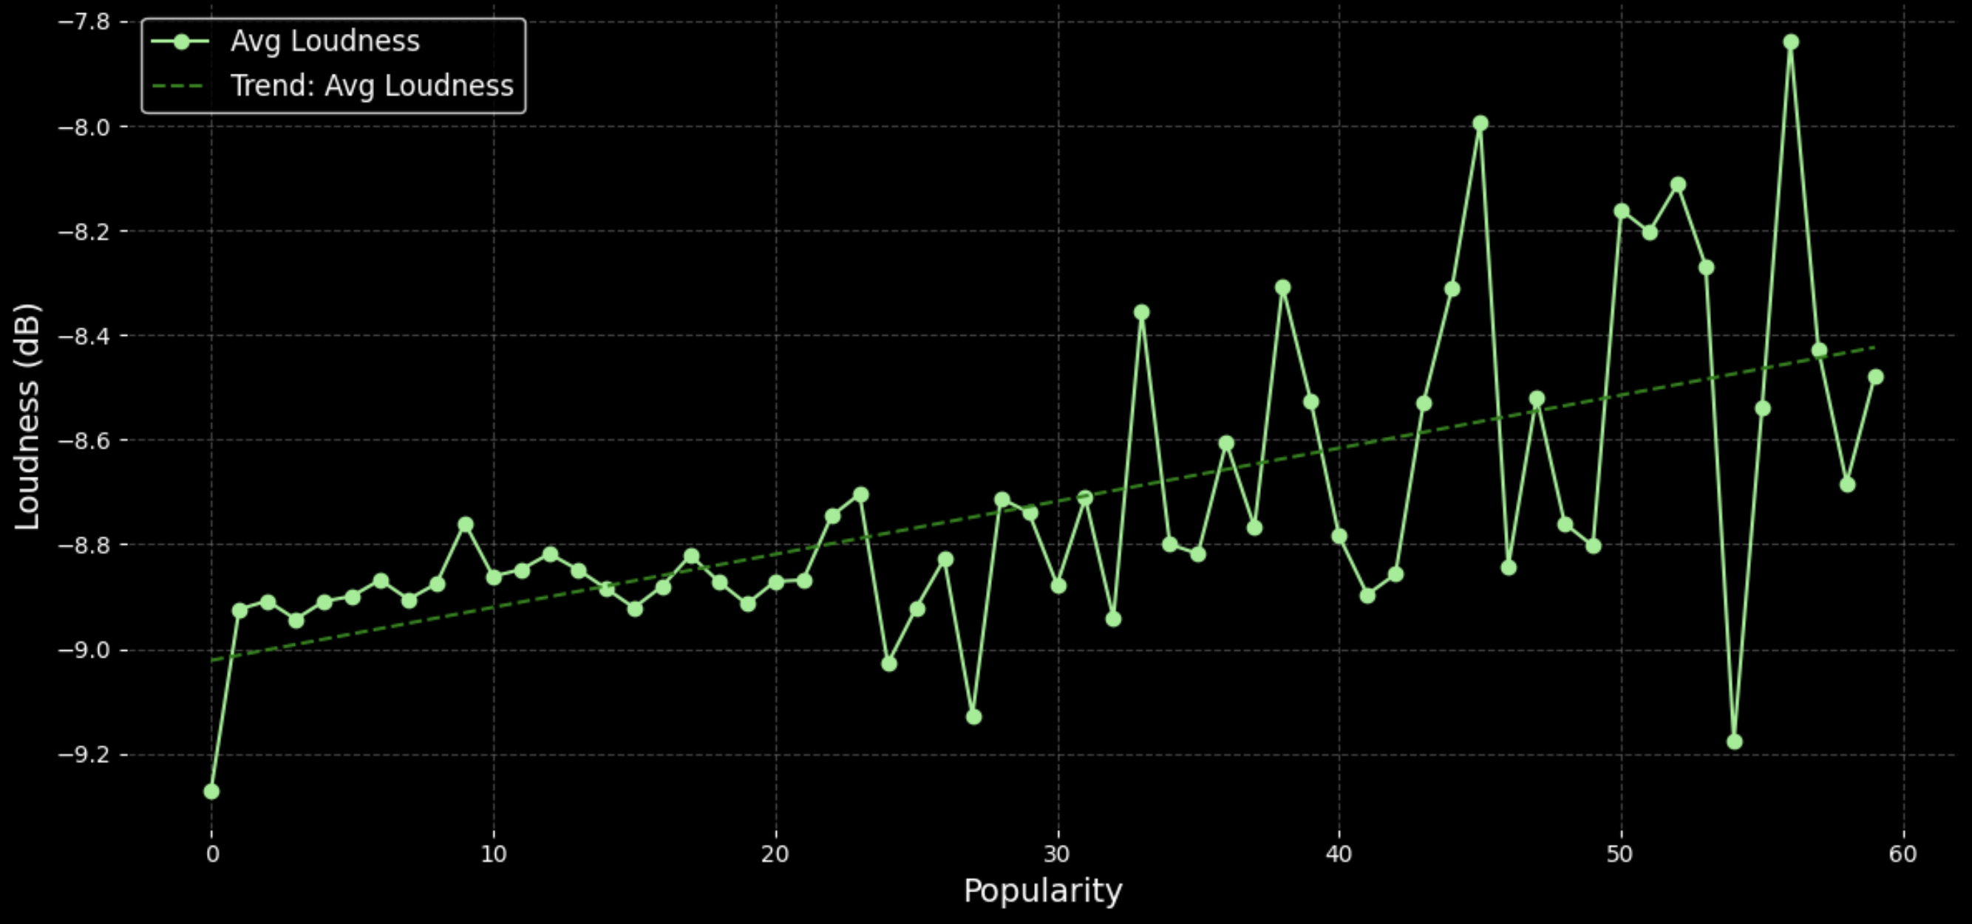
Loudness vs Popularity
OF THE MONTH

Slide 9
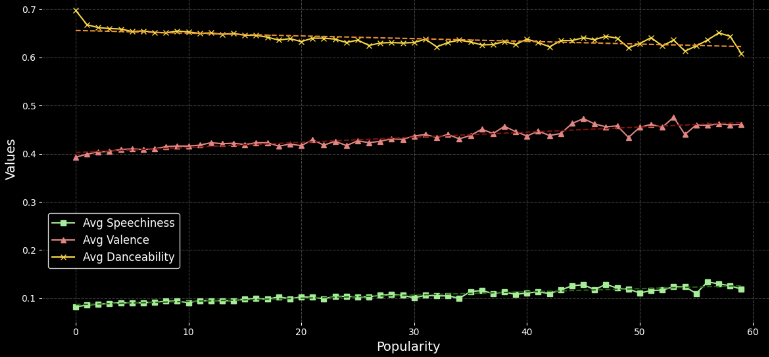
Audio Features vs Popularity
OF THE MONTH

Slide 10
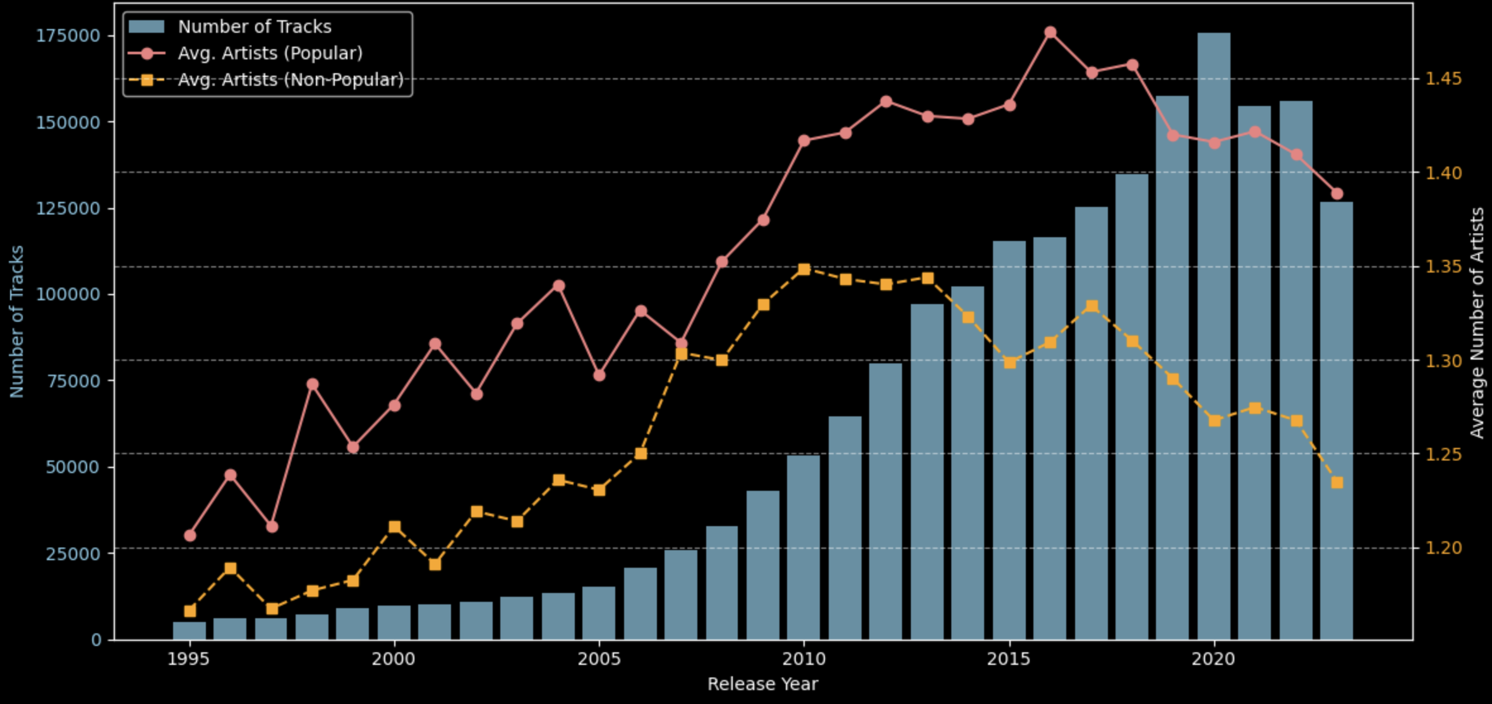
Average Number of Artists per Release Year

Slide 11

Conclusions &
Factors Influencing Popularity
Text Readability: Lyrics that are clear and easy to follow.
Slightly Above Moderate Loudness may contribute to higher track popularity.
Valence: tracks that evoke feelings of happiness
Below-Average Track Duration: Shorter tracks tend to perform better.

Slide 12



Major Obstacles
Trying to query before creating indexes
Using MySQL GUI to upload CSVs

Slide 13


THANK'S FOR WATCHING
LEON BITTIS
SERGEJ KURTASCH

